Slide 1
NAME:- ABHISHEK TRIPATHI
ROLL NUMBER:- 021330024452
PRODUCT NAME :- PENCIL
OPERATIONS

Slide 2


INTRODUCTION:-
From sketching artists to scribbling students, the pencil has been a constant companion for centuries. But there's more to this simple stick of graphite and wood than meets the eye. This project delves into the fascinating creative potential of pencils, revealing the impact they have created on our daily lives.
Brands in the Global Pencil Market
The global pencil market is dominated by several iconic brands that have established themselves through quality, innovation, and branding. These include Faber-Castell, Prismacolor, Crayola, Ticonderoga, and Muji.

Slide 3

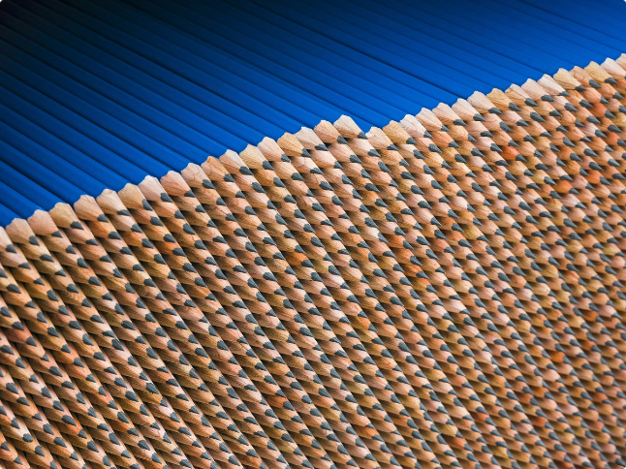
Raw Materials for Pencil Making
Wood
Graphite
High-quality cedar wood is the primary component for the pencil's casing.
The core of the pencil is made from a mixture of graphite and clay.
Ferrule
Eraser
The metal band that connects the pencil's eraser to the wooden casing.
The erasable tip at the end of the pencil, typically made from rubber.

Slide 4
Tools and Equipment for Pencil Production
Cutting Tools
Mixing Equipment
Assembly Machinery
Saws, blades, and trimmers to shape the wood casing.
Blenders and extruders to combine the graphite and clay into the core.
Machines to insert the core, attach the ferrule, and add the eraser.

Slide 5
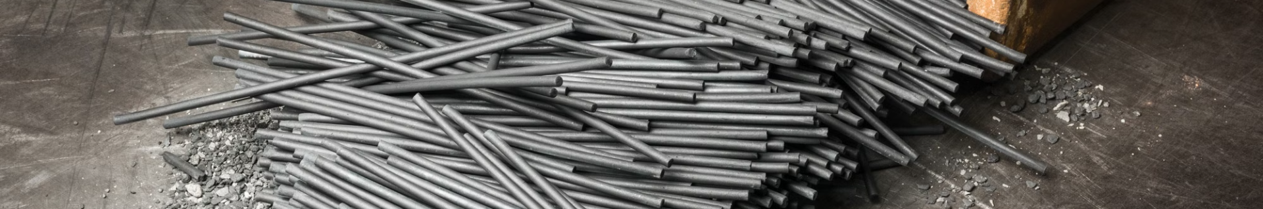
The Pencil Transformation Process
Wood Preparation
Final Assembly
The cedar wood is cut, shaped, and hollowed out to create the casing.
The ferrule and eraser are attached to complete the pencil.
1
2
3
Core Insertion
The graphite-clay core is carefully inserted into the wooden casing.

Slide 6

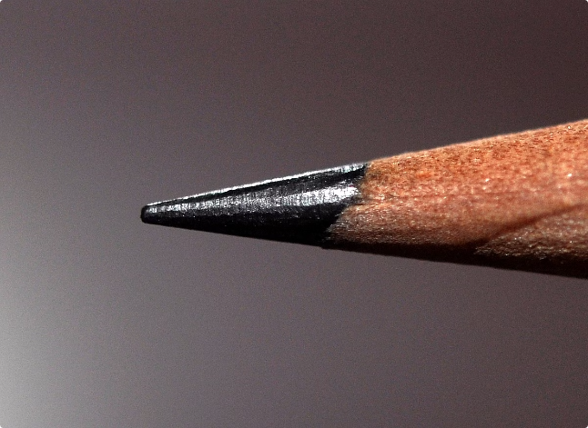
The Finished Pencil Product
1
Precision-Crafted
2
Durable
Pencils are designed with tight tolerances for a smooth writing experience.
The wood casing and ferrule provide strength and resistance to breaking.
3
Versatile
4
Sustainable
Pencils can be used for writing, sketching, shading, and more.
Many pencils are made from renewable, eco-friendly materials.

Slide 7


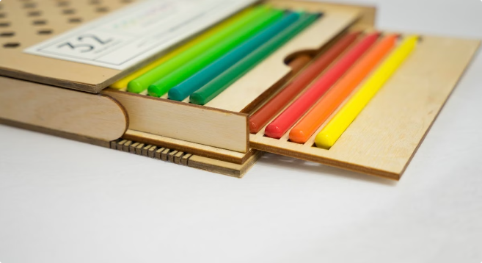
Packaging and Distribution of Pencils
Packaging
Pencils are often sold in boxes, tubes, or bundled packs for retail.
Distribution
Pencils are shipped globally through a network of wholesalers and retailers.
Retail Channels
Pencils are available in office supply stores, art shops, and general merchandise outlets.

Slide 8


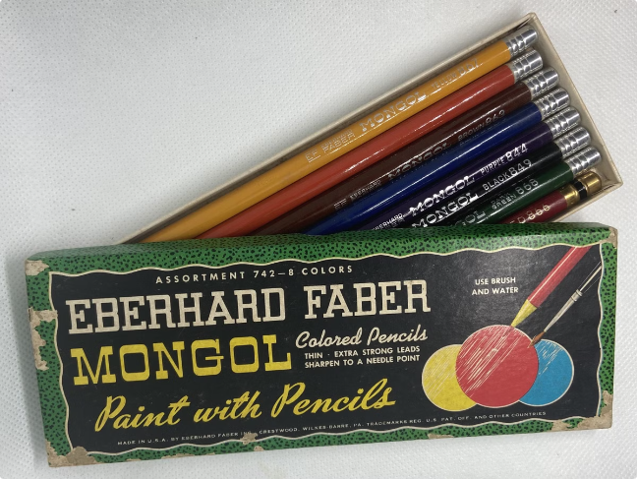


Marketing and Branding Strategies for Pencils
Product Design
Brands focus on unique shapes, colors, and features to stand out.
Advertising
Campaigns highlight the quality, creativity, and sustainability of pencils.
Partnerships
Collaborations with artists, schools, and influencers build brand loyalty.

Slide 9


Challenges and Opportunities in the Global Pencil Market
Challenges
Opportunities
Competition from digital alternatives
Growing demand for sustainable products
Fluctuating raw material costs
Expanding into emerging markets
Shipping and logistics complexities
Product innovation and customization

Slide 10

CONCLUSION:-
the pencil is more than just a simple writing instrument - it's a key to creativity, a symbol of knowledge, and a connection to our past. Through its rich history, versatile applications, and continued relevance in the digital age, the pencil has proven itself to be an enduring and essential tool.

